Slide 1
Final Project - Running Man
By: Bill Joseph

Slide 2
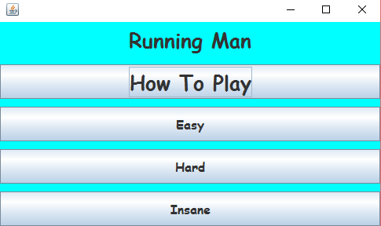
Runner
The Main menu is simple, it has a how to play the game, following it are 3 buttons with 3 different difficulties to the game.

Slide 3

The Player
The Player class is quite simple, it is where the player image is drawn and where the player’s hitbox is determined, in addition checks falling and jumping via keyevents which is just the up arrow, when the player jumps it uses a gradual increase and decrease so it appears smooth

Slide 4

The Wall
The wall works very similarly to the player class except that the speed the wall moves from right to left is determined based on your score(next slide), and what difficulty was selected.

Slide 5

The score
Score increases when the x axis from the wall is equal to the x axis of the player, and the player's hitbox is not triggered.

Slide 6

Highscore
The high score is based on what the highest recorded score from when the game was first ran.

Slide 7
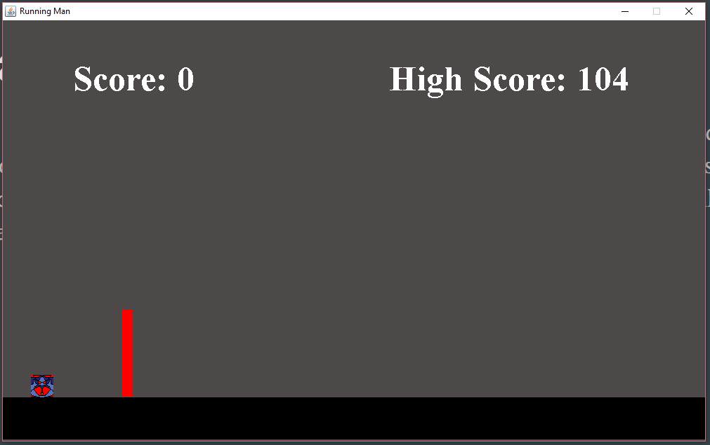
Core game class
Inside the game class, when the hitbox is triggered it will end the game giving you an option to close the game or to restart(keeping the highscore). Inside of this class is how the score is added. In addition this is how the timer functions and where all of the images are painted onto the canvas.

